Slide 1
Self-Positioning Universal 12-lead ECG (electrocardiogram) Reconstruction System
AutoLeadX
“ Decode hearts anywhere, anyhow, anytime ”
National Yang-Ming Chiao-Tung University (NYCU)
Advisor: Prof. Vincent S. Tseng , Institute of Computer Science and Engineering
Team members: Alice Chu, Cody Chen, Eileen Wu, Alvin Chen, Ally Teng, College of Medicine

Slide 2


72 y/o man with CAD history, acute onset chest pain and palpitation
3-lead mobile ECG devices
Inaccurate electrodes placement…

Slide 3
How can AutoleadX do ?
72 y/o man with CAD history, acute onset chest pain and palpitation
3-lead mobile ECG devices
Inaccurate electrodes placement…

Slide 4
72 y/o man with CAD history, acute onset chest pain and palpitation
3-lead mobile ECG devices → Reconstruct to 12-lead ECG
Inaccurate electrodes placement… → Automatic lead correction

Slide 5
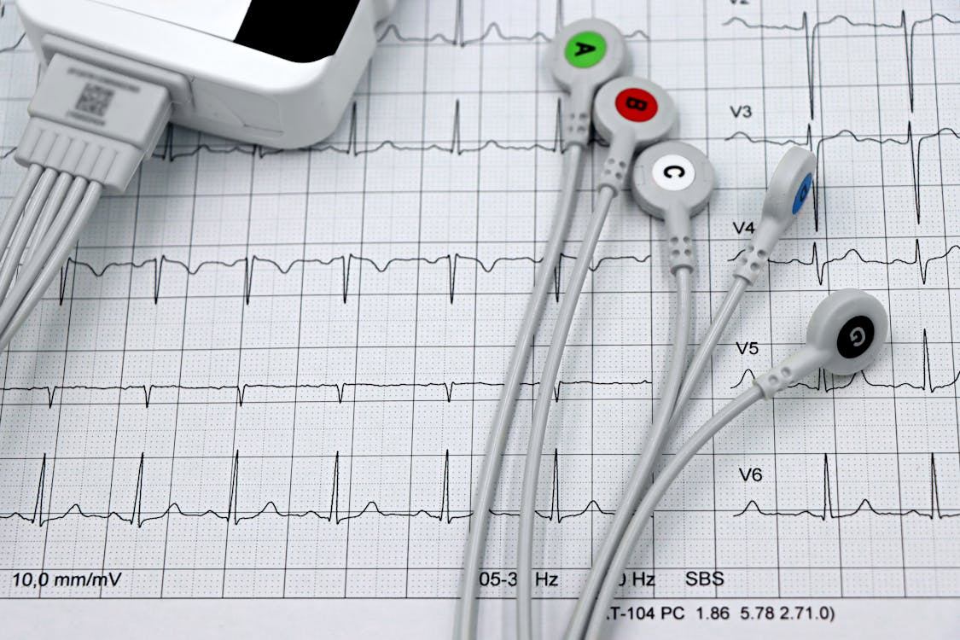

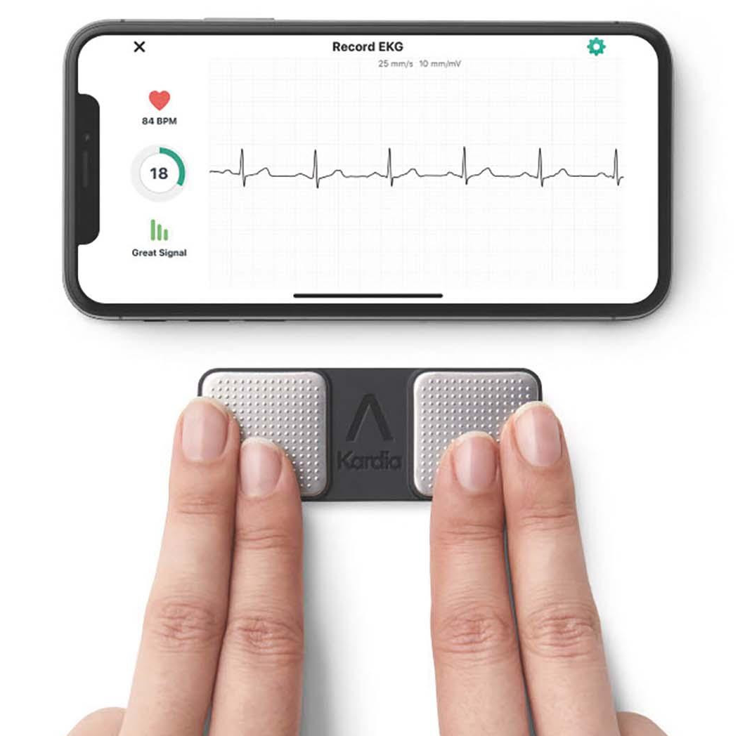

Slide 6
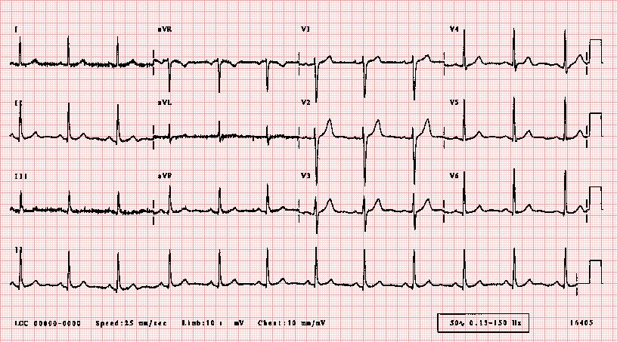
12-lead ECG GOLD STANDARD

Slide 7
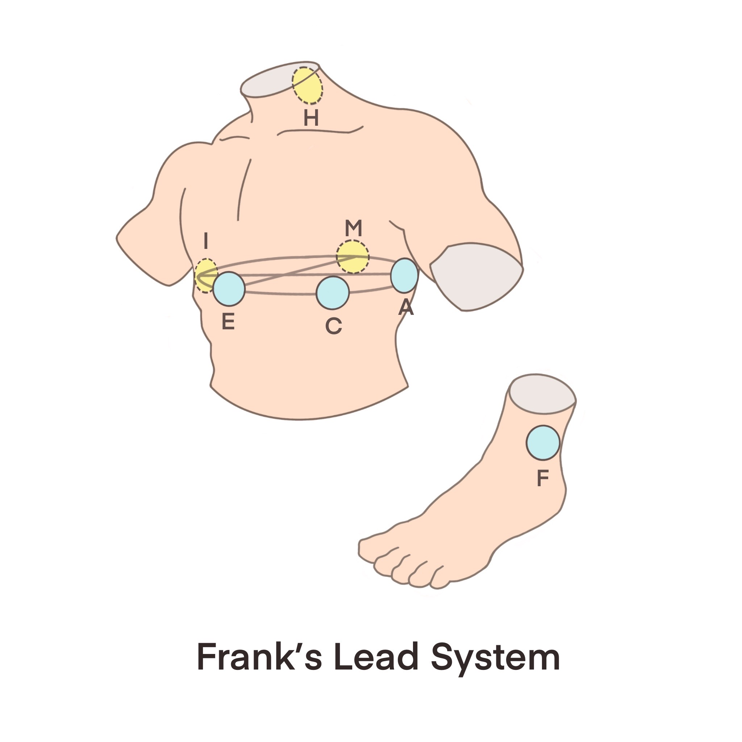
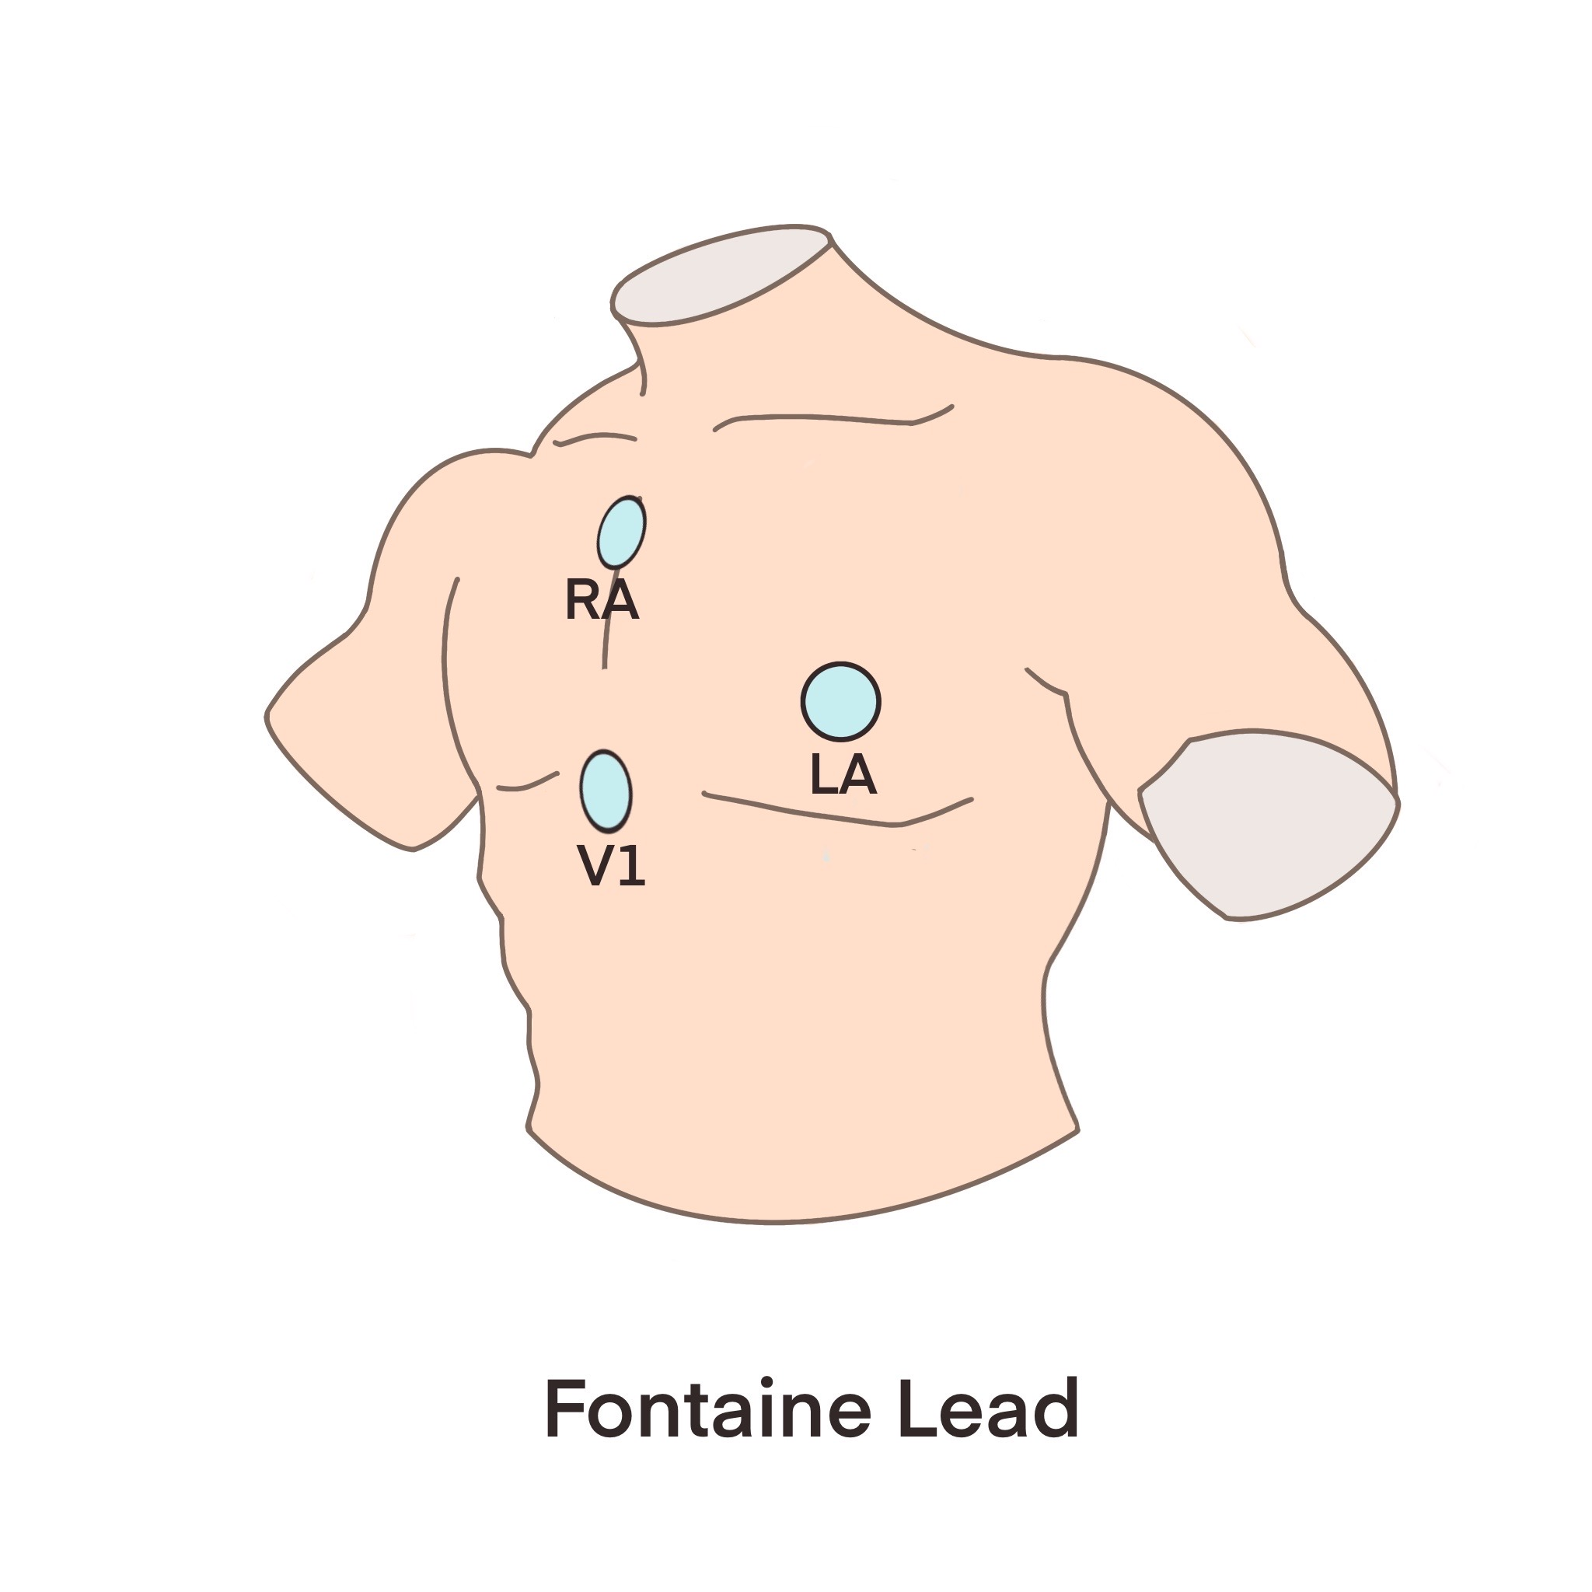
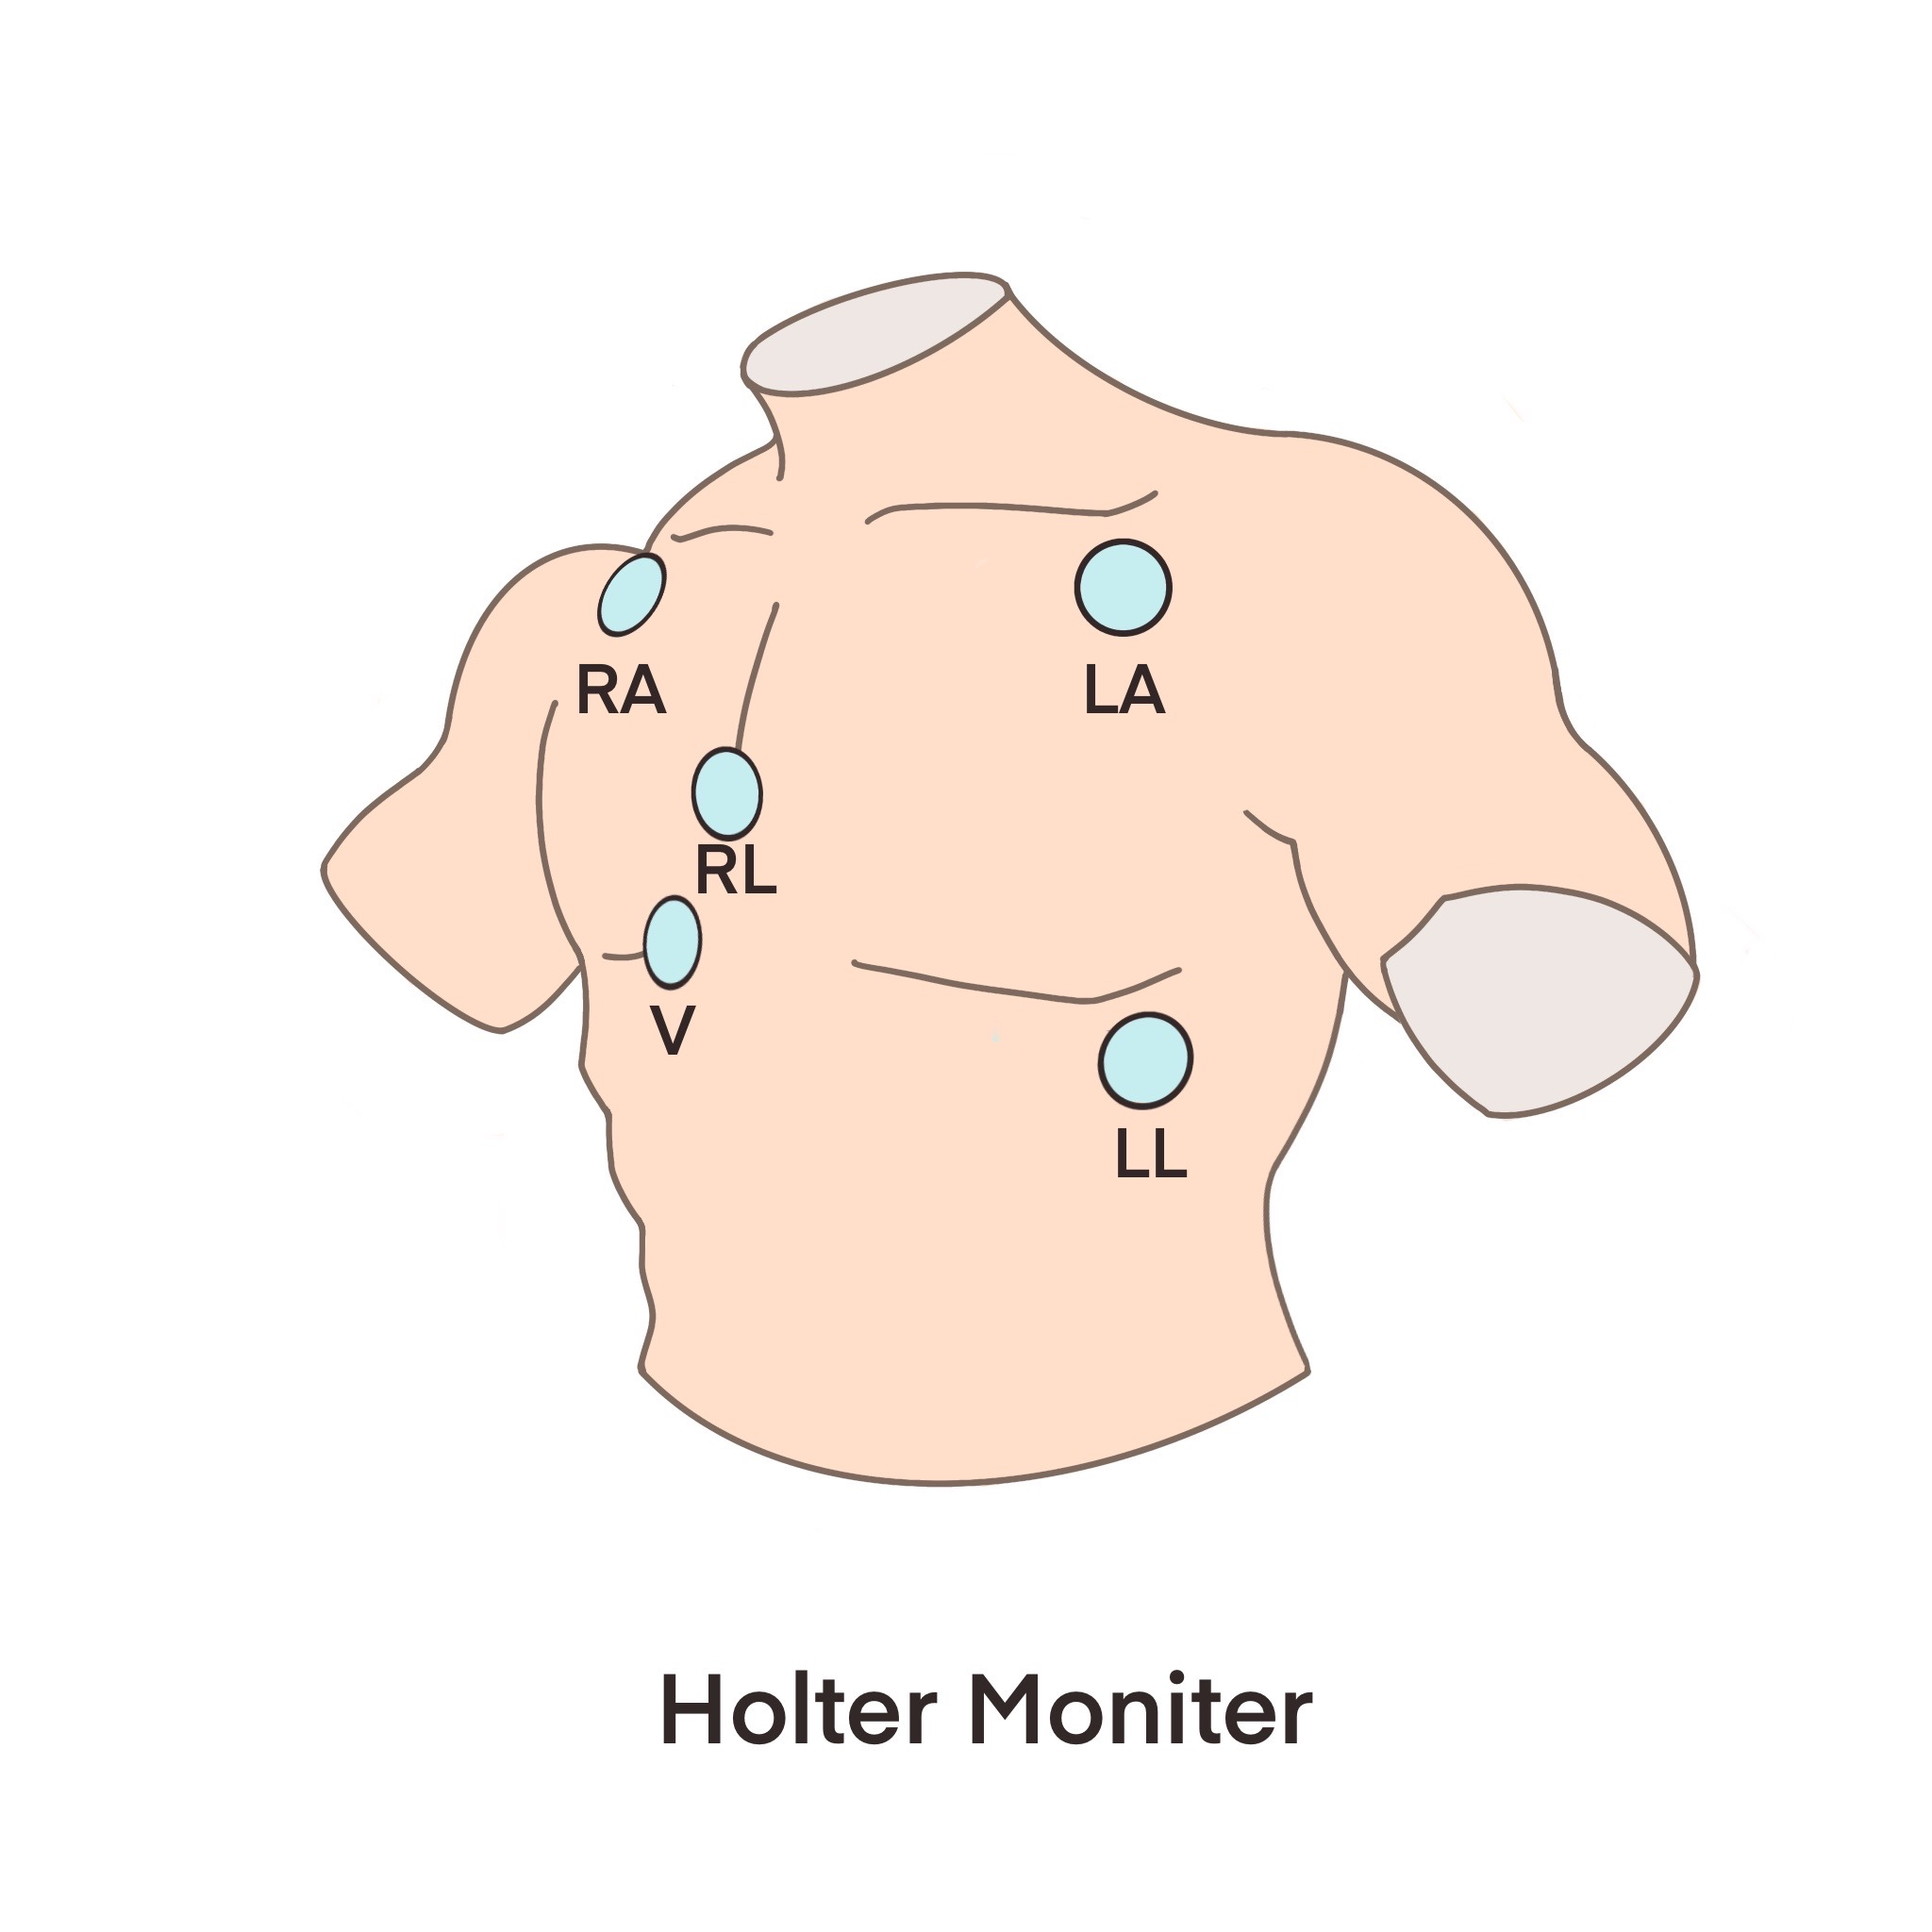
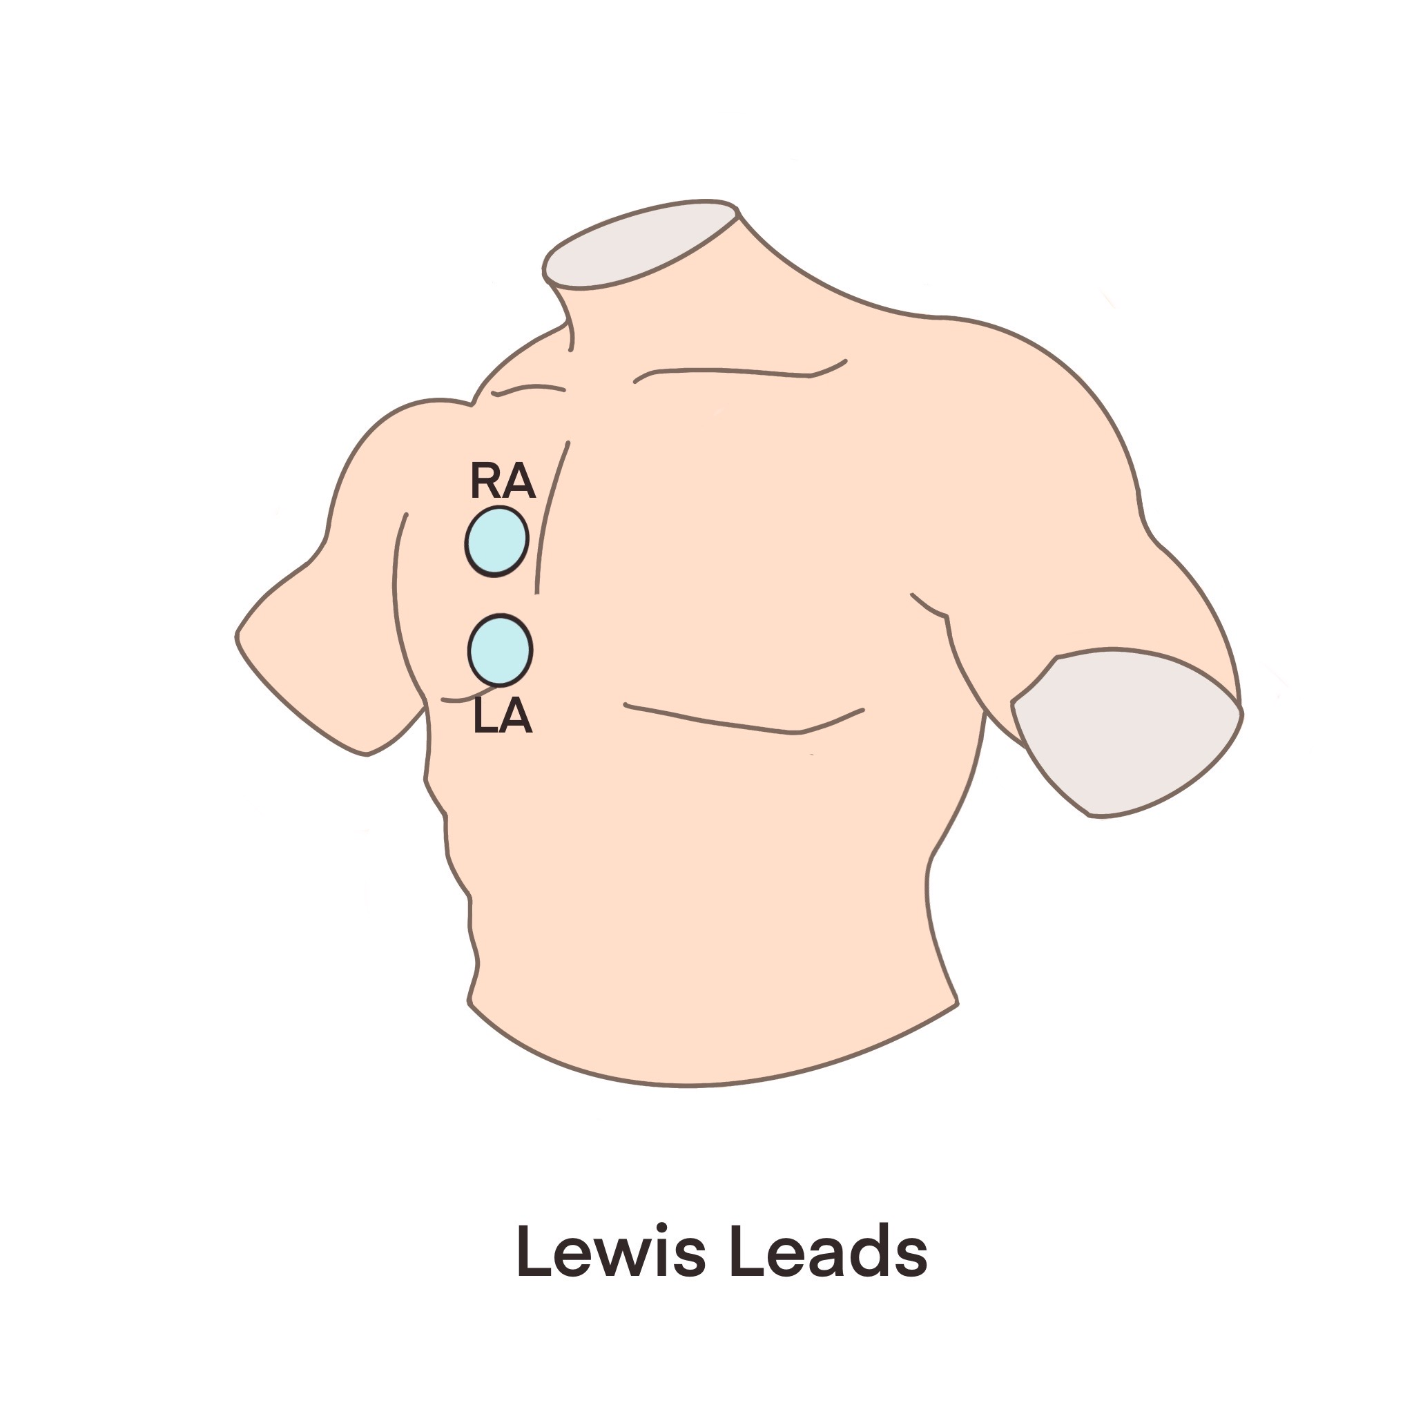
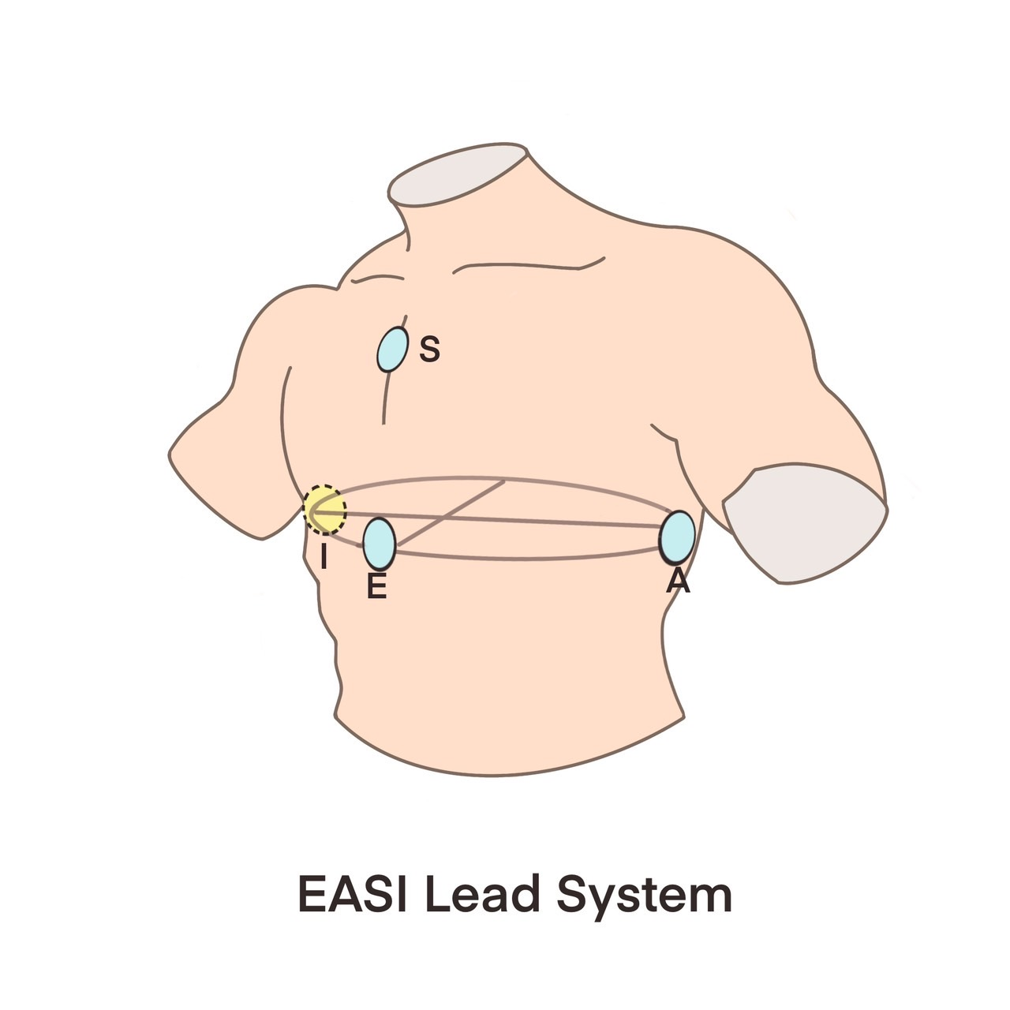
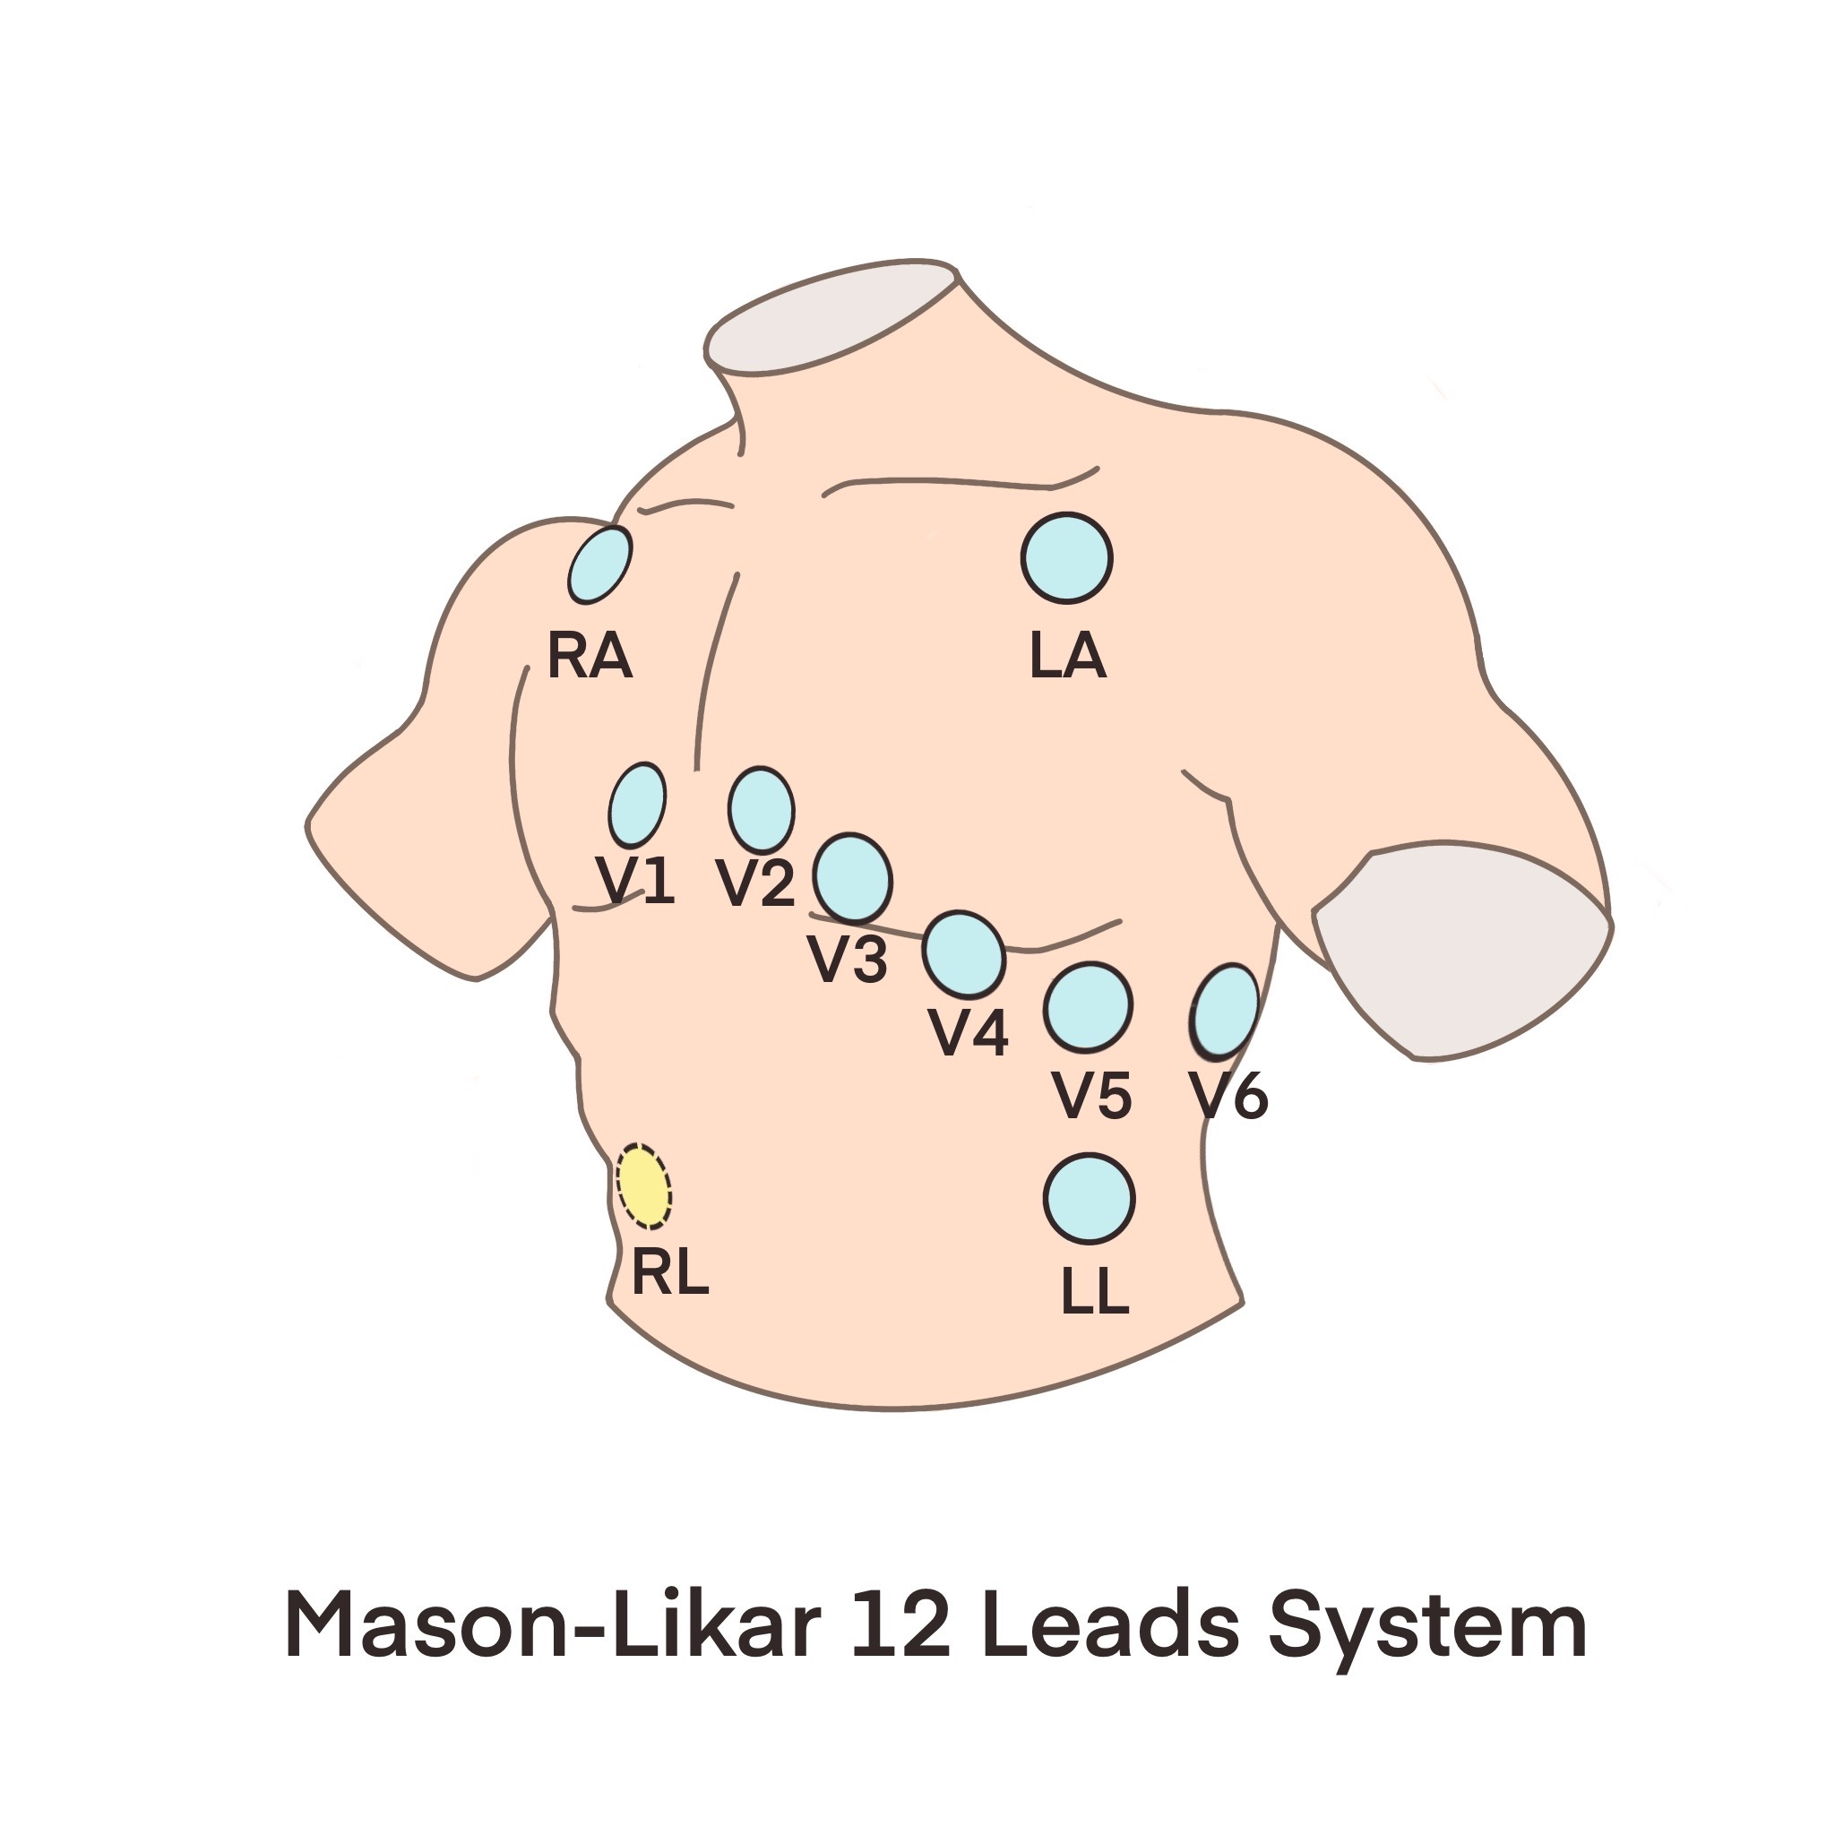
Examples of various ECG electrode configurations
Mobile / Wearable ECG devices reduced lead system

Slide 8
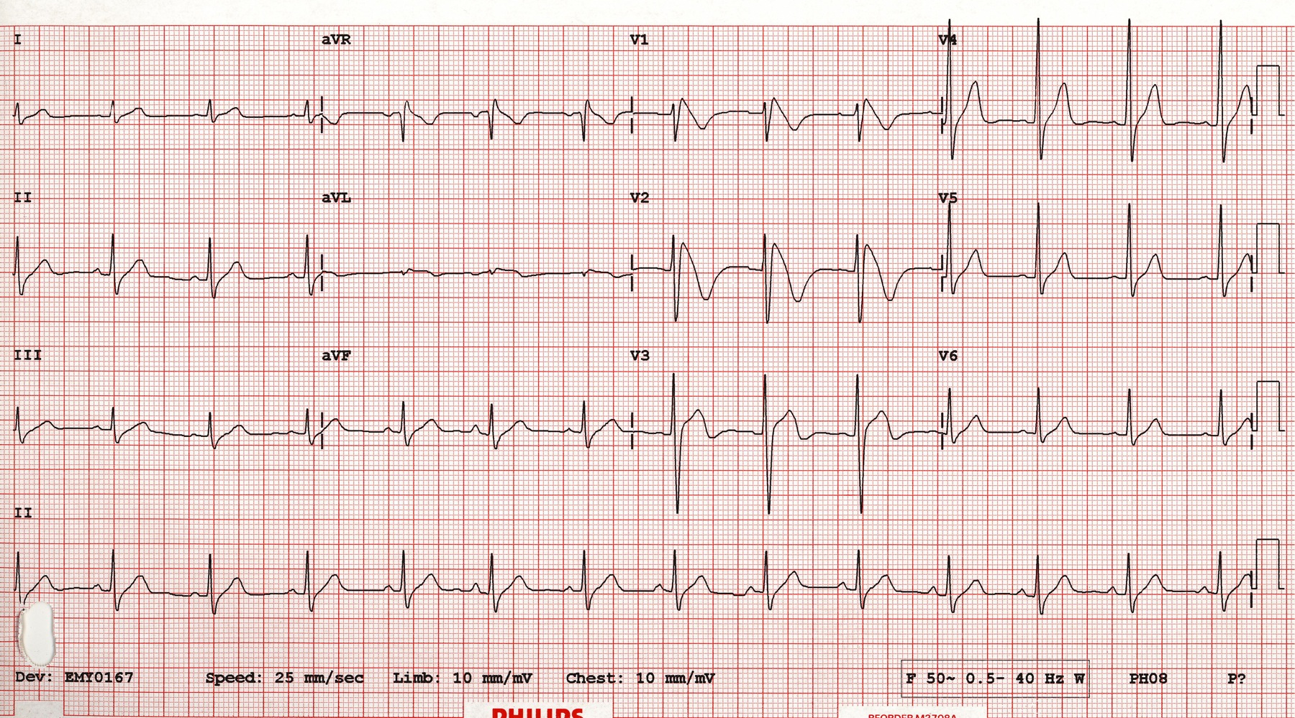
Challenge
Lack of generalizability : Device-specific reconstruction algorithms
Reconstruction
algorithm A
Config A
Reconstruction
algorithm B
Config B
Standard 12-lead ECG
Reconstruction
algorithm C
Config C

Slide 9
Challenge
Lack of generalizability : Device-specific reconstruction algorithms
Inaccurate placement of electrode by patients at home, even health professionals

Slide 10
Solution
Config A
For AI model to detect diseases
Self-positioning
Universal ECG model
Config B
Transform to Standard 12-lead
Config C
Notes:
Such universal processing of the signals can unify the reconstruction algorithm and the AI model that detect diseases

Slide 11
Self-positioning ECG model
Key features
Any Device
Identify the recording site information
Any Recording Sites
No predefined recording site specifications Required
Any Number of leads
Misplacement Correction

Slide 12
Innovative Solution

Slide 13
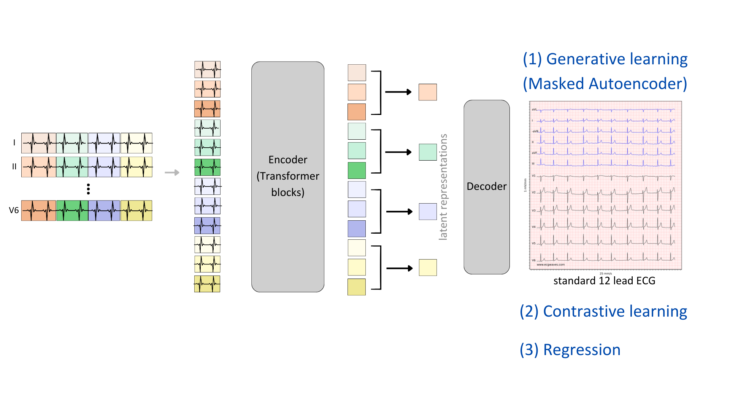
Model learning
Self-supervised Learning Model with comprehensive training strategies
1
Generative learning (Masked Autoencoder)
2
Contrastive learning
3
Regression

Slide 14
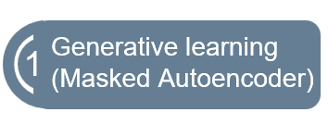

Model learning
Predict the missing part in an individual sample

Slide 15
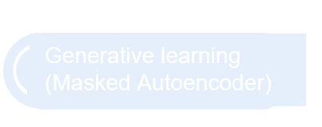
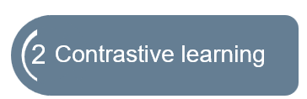
Model learning
Predict the missing part in an individual sample
Predict relationship between multiple data

Slide 16
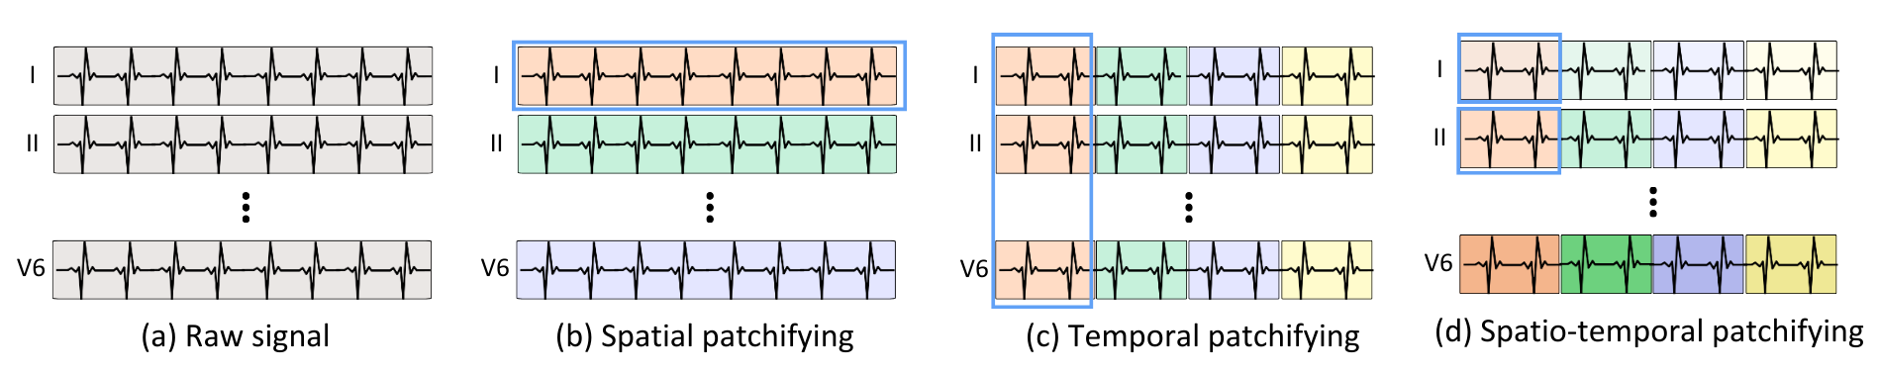
Model learning
Generative learning
Missing Data
Reconstructed data

Slide 17
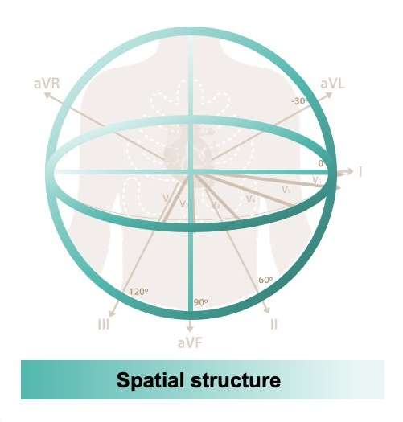
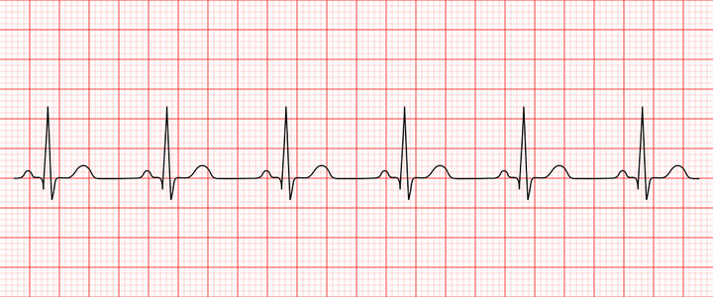
Model learning
Time (s)
Temporal structure

Slide 18
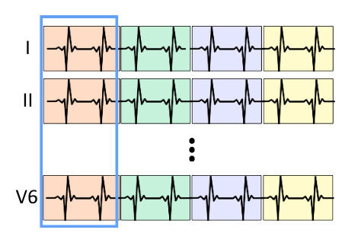
Model learning
1
Temporal patchifying
Spatial patchifying

Slide 19
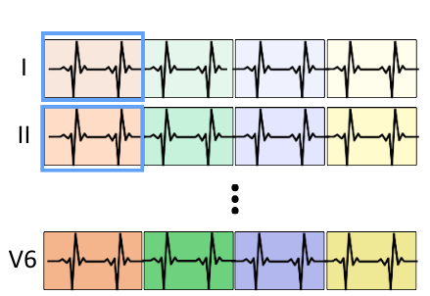
Model learning
Spatial - Temporal patchfying

Slide 20
Model learning

Slide 21

Model learning
Positive pairs
Negative pairs
Positive pairs

Slide 22
Our Method
Notes:
接下來我會更詳細的介紹我們的模型。

Slide 23
Input
Sample k channels from n channels, k = 1, 2, 3….., n
in permuted order
n varies for different data source
Ex. n = 12, when using standard 12-lead
Batch 1: k=3 (I, II, V2), (aVF, III, V6) , (V6, aVF, III)…
Batch 2: k=4 (I, III, aVF, V1), (II, aVR, V3, V4) …
Ex. n = 35 or more, when using multi-channel ECG / BSPM data
Automatically identify recording sites
Takes any position, any number of leads as input
Notes:
一般的ECG模型都是吃乖乖照順序排好隊的導程，例如12導的模型輸入就會是固定1~12的順序，所以模型可以依照順序來知道這個訊號是哪一導，但我們為了訓練模型不要依賴順序，而是要直接從波型當中推測出導極位置，所以我們在輸入的地方做了點巧思。導程順序會是打亂的，導程數目也是隨機的從N導當中抽K導。舉例來說當我們使用標準12導的dataset時，可能抽到輸入是I, II, V2, 或是 avf, III, V6導程等等，當然我們也可以抽4導、5導都可以，當我們使用更多導程的資料例如Body Surface Potential Mapping，我們則會從35導或是更多導當中來抽。

Slide 24
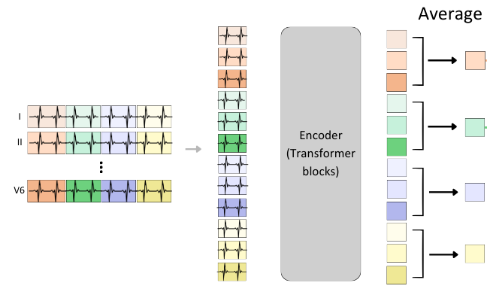
Encoder
Spatiotemporal patchifying
Masking
Vision Transformer
Obtain latent representation (signal feature extracted by the model)
Notes:
輸入接下來就會做Spatiotemporal patchifying, 切成一塊一塊的，經過masking 之後，丟進Transformer裡面，從Transformer裡面出來的latent representation (可以想像成解讀過後的訊號feature)
(以下刪掉) 其數量會跟導程數成正比，如果input的導程數變2倍，中間這些方塊的數量也會變兩倍。但後面的模型需要一致的dimension，所以我們這邊就把每個時間窗的patch的feature加在一起平均。用以達到應對不同輸入導程數量的挑戰。

Slide 25
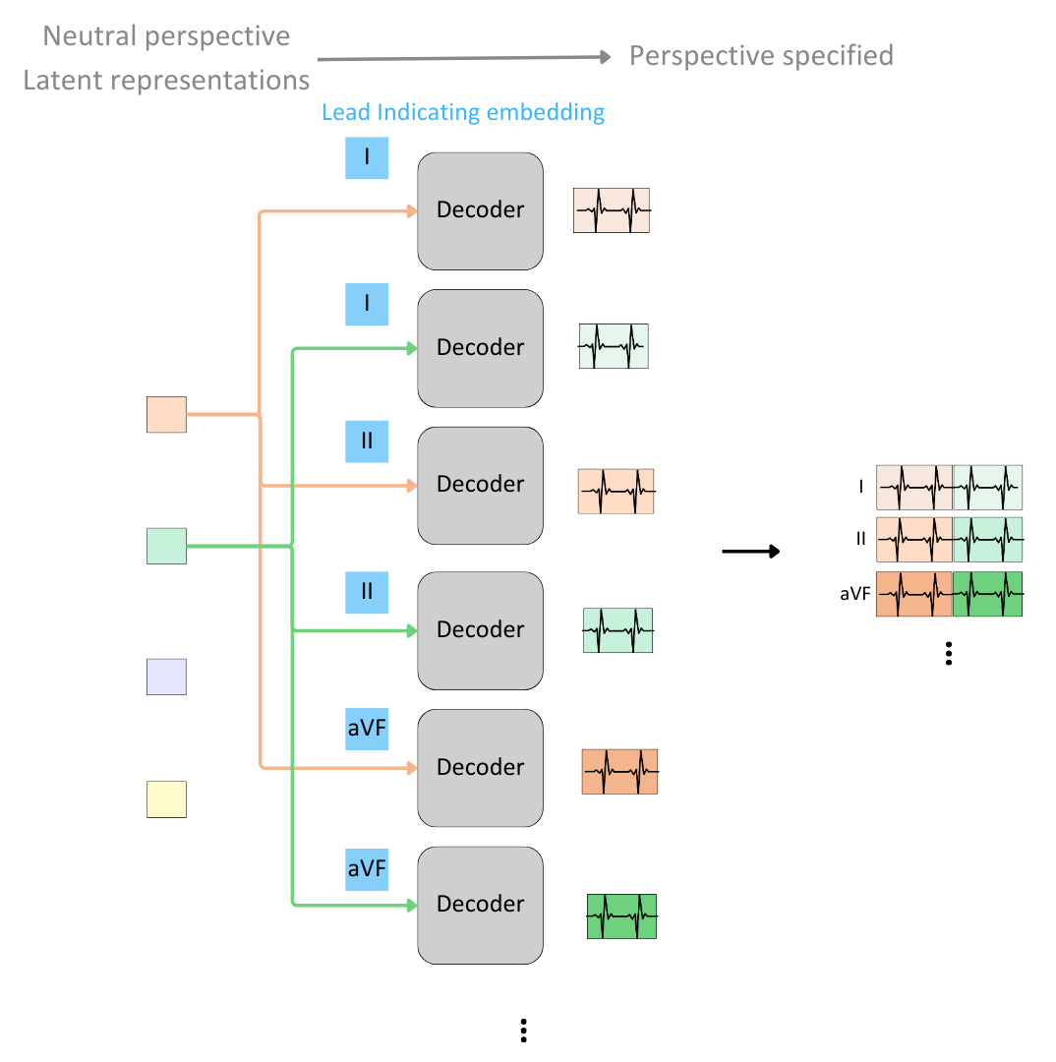
Decoder
Shared decoder
Lead indicating embedding
latent representation
“no perspective”
3D object
Standard 12 lead
“desired perspective”
2D image
(specify imaging angle)
Notes:
經過encoder之後，我們會得到”中立”視角的 latent representation，再用decoder 投影成想要的導程。

Slide 26
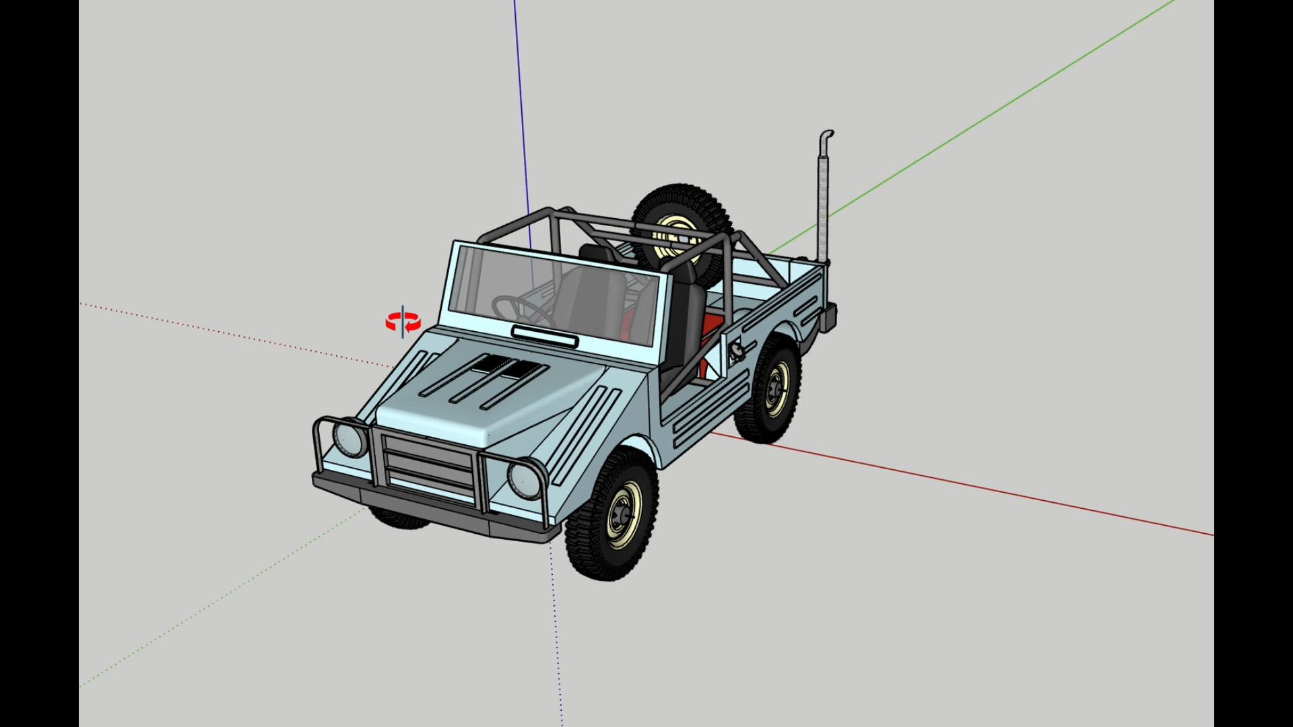
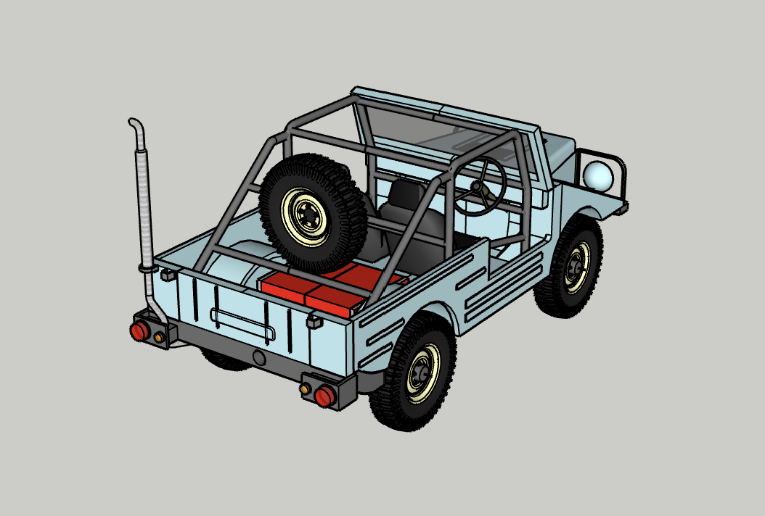
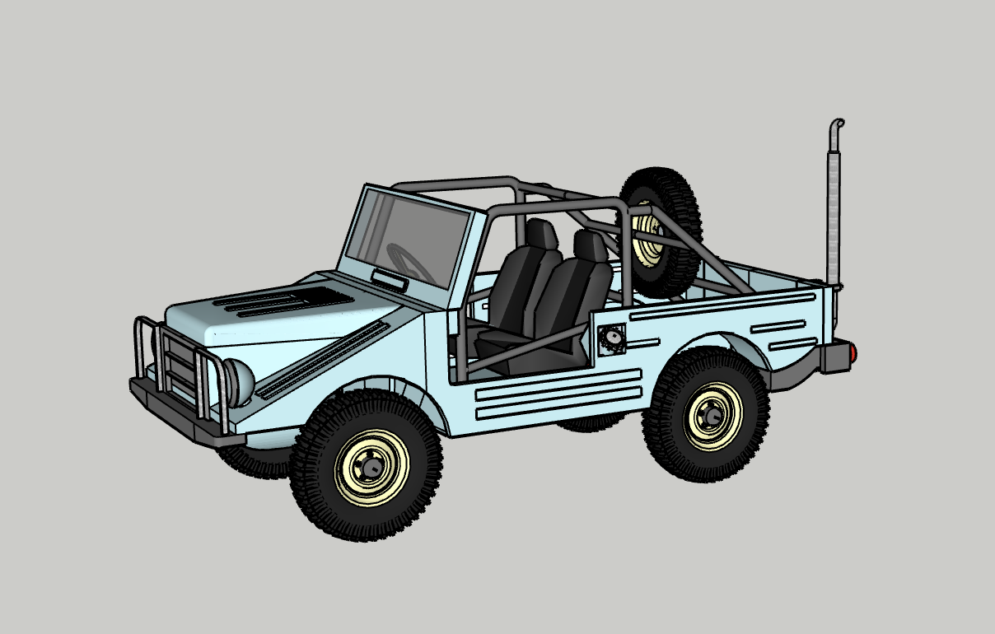
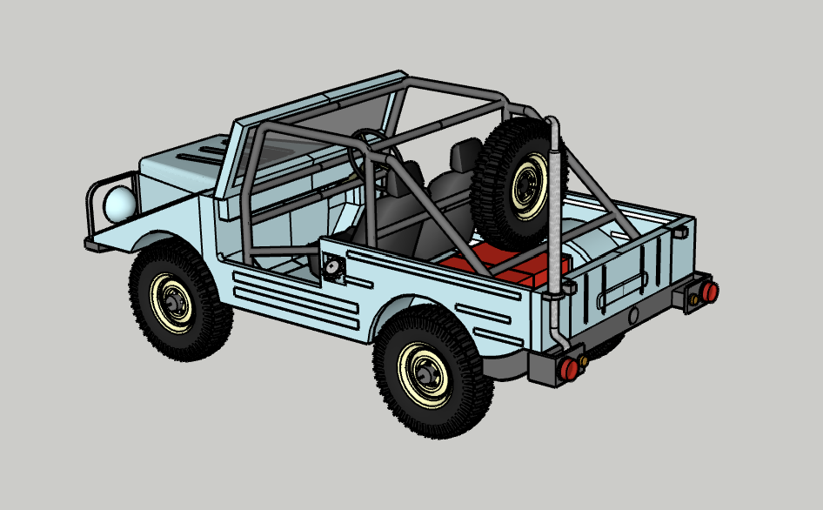
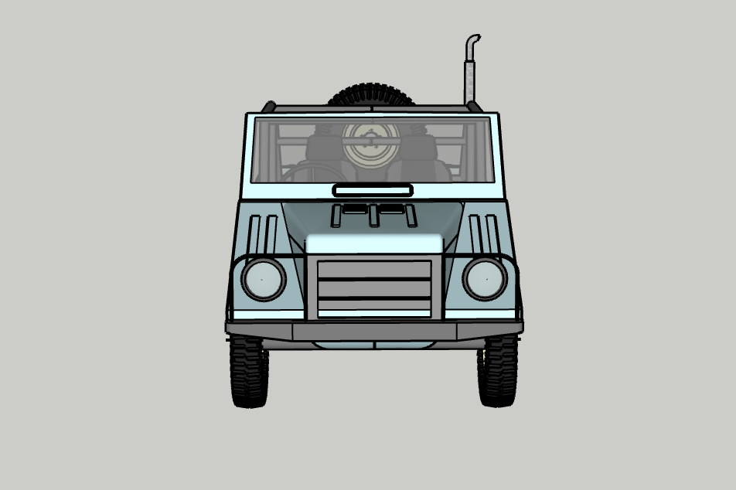
Decoder (Cont’d)
latent representation
“no perspective”
3D object
Standard 12 lead
“desired perspective”
2D image
(specify imaging angle)
Notes:
可以想像成原本我們有一個物體3D的完整資訊，然後我們選定一個想要的拍照角度，拍一張照變成2D影像。原本的latent representation包含完整的心臟資訊，那decoder會再用12個不同的角度去解讀，得到12個導程的投影量。

Slide 27
Training Objective - 1
Generative Learning
Use subset of leads to recover unseen leads
For standard 12 lead: Subset of standard 12 lead → 12 lead
For multi-channel: Subset of multi-channel → multichannel
Notes:
再稍微更詳細講一下我們三個訓練目標，第一個， generative learning，會把資料一部分導程的抽掉，用模型看的到的導程去推測出那些他沒看到的導程，舉例我們從12導裡面丟3導進去，希望模型推測出其他沒看到的9導。

Slide 28
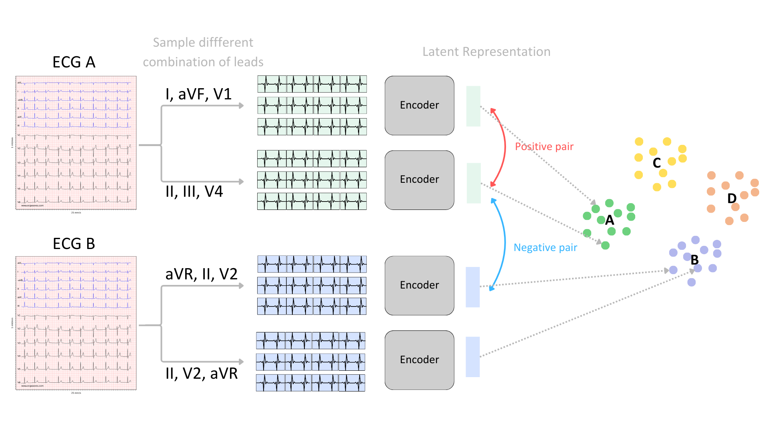
Training Objective - 2
Contrastive learning
Positive pairs
Different combination of lead
subset sampled from the
same data
Negative pairs
different combination of
lead subset sampled from
different data
We hope to get the same latent representation, no matter the heart is viewed from what perspective
Notes:
第二個訓練目標是contrastive learning，如果是從同一資料抽出來的不同導程組合，我們會定義成positive pair ，也就是encode出來應該要長的像的，那如果是從不同筆資料抽出來的，就是negative pair，也就是encode出來應該要長的不像。舉例來說這病患A先抽出I, AVF, V1, 這三導，再來另一個抽法II, III, V4, 這兩個encode出來應該要越接近越好。反之跟病患B抽出來的資料則是要離越遠越好。我們想要達到的就是，不管我們心臟是用甚麼角度去看，model得到的feature都是類似的。

Slide 29
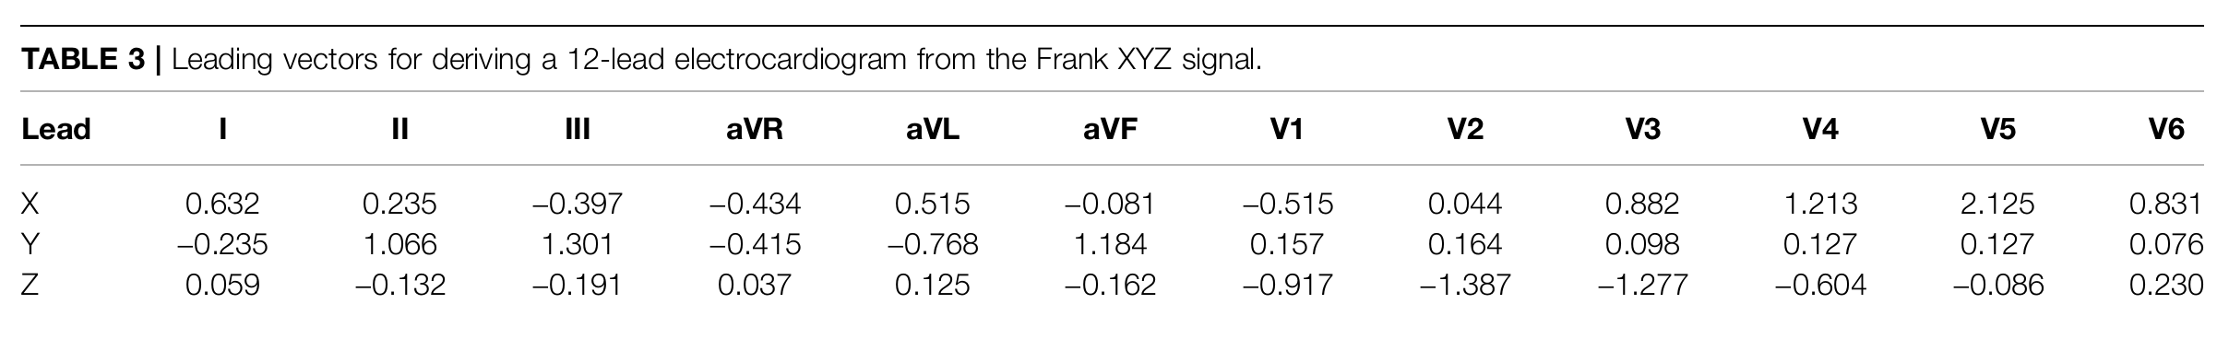
Training Objective - 3
Regression
Output (x, y, z) : location of the electrodes / direction of the vector
enhance the model’s ability to identify recording sites information
Ref. Vondrak, Jaroslav, and Marek Penhaker. "Review of processing pathological vectorcardiographic records for the detection of heart disease." Frontiers in Physiology 13 (2022): 856590.
Notes:
最後，為了強化模型分辨導程位置的能力，我們再額外加了讓模型輸出導程的方向向量的值，也就是對每一導輸入，會輸出(x, y, z)三個值，代表她推測這一段波形是來自哪個方向的導程。

Slide 30
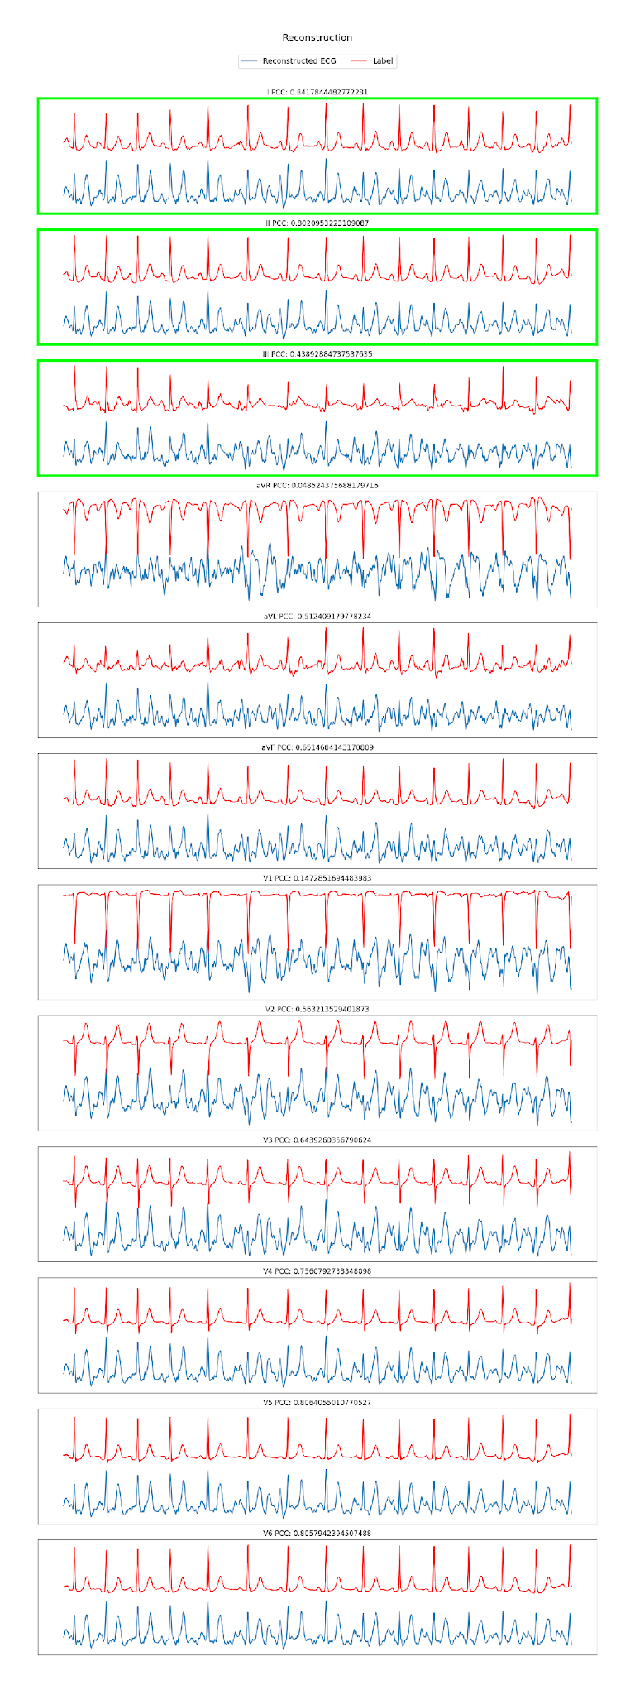
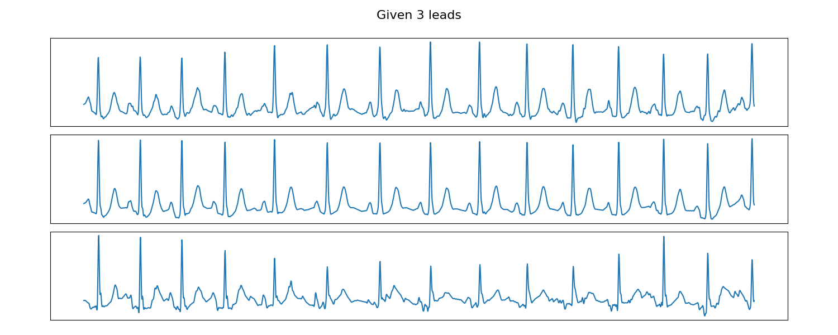
Result
Given 3 unspecified lead ECG
12 standard lead ECG reconstruction
Notes:
這是我們初步的結果，我們隨機從12導抽了3導，隨機的順序，模型也不知道是哪3導，然後做重建。

Slide 31
Result (Cont’d)
Evaluation:
Pearson Correlation Coefficient
Average performance
1 lead → 12 lead : 0.282
3 lead → 12 lead : 0.357
Notes:
重建出的訊號在這張圖是藍色，標準答案是紅色。目前我們是用Pearson Correlation Coefficient
(相關係數)來計算兩個訊號之間的相似度，這個例子裡面重建出V4的相關係數大概是0.75。我們主要實驗了抽一導和三導來重建12導，得到的平均相關係數分別為0.282和0.357。雖然還沒有很理想，但是我們的模型還沒完全寫完仍有可以優化的地方，預期還有進步的空間。

Slide 32

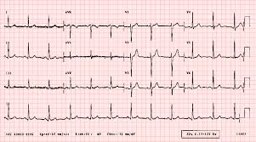
Our technology
Patient I with Device A
Our model
AutoleadX
Patient II with Device B (misplaced)
Notes:
有了這樣的技術，不同的病患使用不同的mobile ECG device，就算導程的設計不一樣甚至是病患自己貼歪，都可以透過這個universal的model來轉換成醫生看的懂的12 導程ECG。

Slide 33
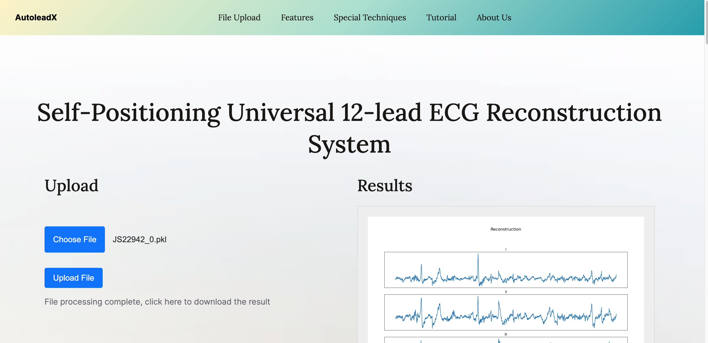

Our Website
Visit https://autoleadxapp.com
Notes:
我們還有架設一個網站，可以把輸入上傳，然後獲得經過我們server運算重建的12導程訊號。

Slide 34
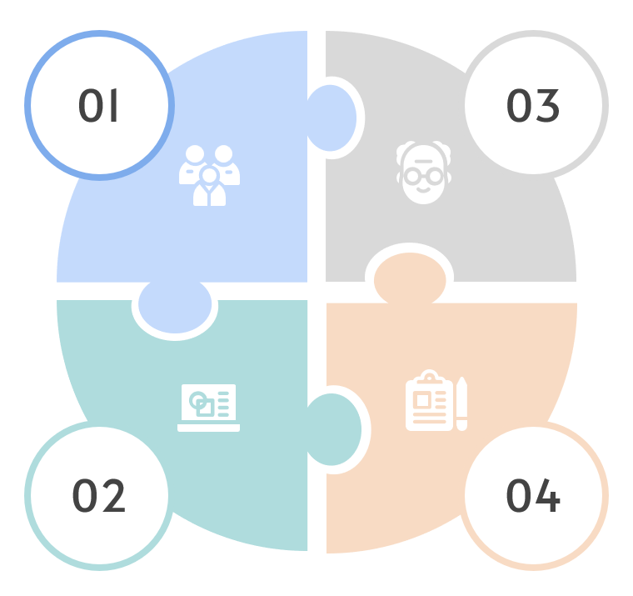
Impact
Human clinicians
Patients
Adapter to human readable 12-lead
Empower non-professional at home
regardless of electrode placement accuracy
AI Applications
Healthcare Industry
Universal encoder
enhance efficiency of developing AI ECG application
low-cost / wearable mobile devices
telemedicine applications
Revolutionize standard ECG practices

Slide 35





AutoLeadX
National Yang-Ming Chiao-Tung University (NYCU)

